Slide 1
Case Study 2-Bellabeat
In this fictional case study, I am a junior data analyst working at Bellabeat. This is the scenario:
You are a junior data analyst working on the marketing analyst team at Bellabeat, a high-tech manufacturer of health-focused products for women. Bellabeat is a successful small company, but they have the potential to become a larger player in the global smart device market. Urška Sršen, cofounder and Chief Creative Officer of Bellabeat, believes that analyzing smart device fitness data could help unlock new growth opportunities for the company. You have been asked to focus on one of Bellabeat’s products and analyze smart device data to gain insight into how consumers are using their smart devices. The insights you discover will then help guide marketing strategy for the company. You will present your analysis to the Bellabeat executive team along with your high-level recommendations for Bellabeat’s marketing strategy.

Slide 2
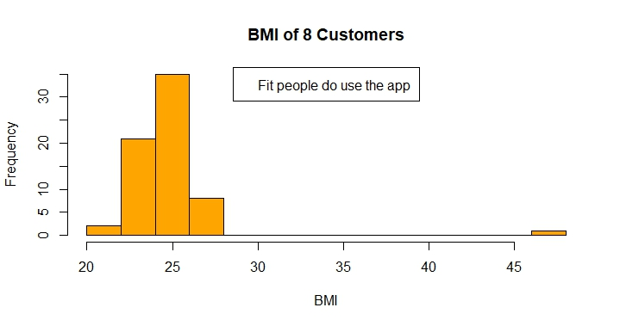
There are customers who have a BMI that is below 30.

Slide 3
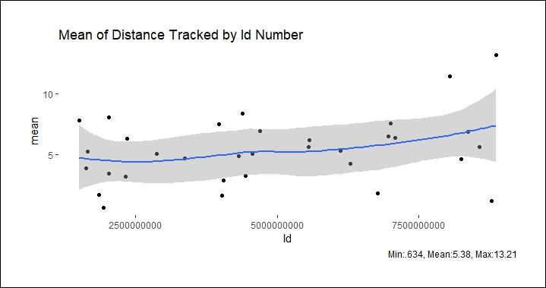
This is the mean of the distance tracked by user Id number. As you can see, the smallest is .634 Km. The max is 13Km. The mean is 5.38 Km. The people who use this are not completely sedentary. The mean is 3.34 miles per day, not a small feat to walk that on a daily basis.

Slide 4
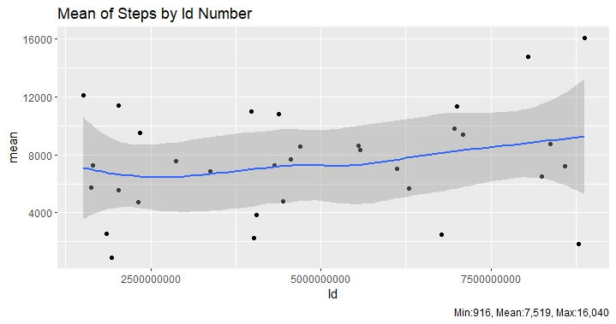
Mean of Steps by ID number The mean of the steps per day is 7519. There are still slightly less than half of the records that are below the average, however. The CDC recommendation is less than this value. It can vary based on the goal. More if you are wanting to lose weight or get in better shape.

Slide 5
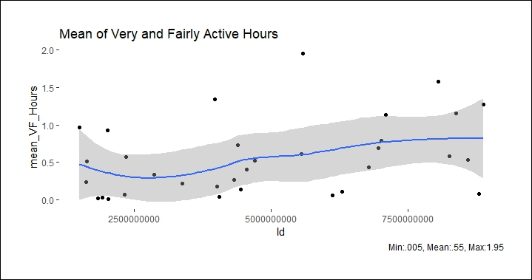
The mean of very active and fairly active hours. As you can see, the mean is half an hour for being active, which isn’t horrible. There are a few that are almost sedentary in the category, however. The CDC does recommend 2 days a week for muscle strengthening and activities that improve balance in addition to steps.

Slide 6
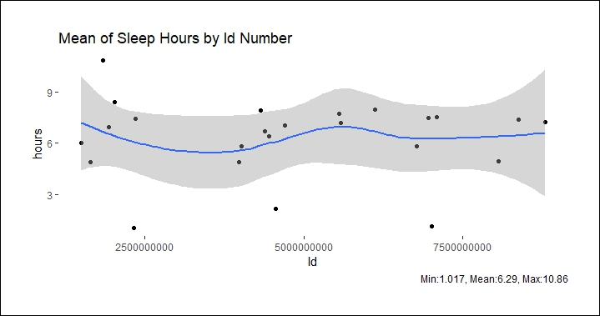
Mean sleep hours As is apparent, the mean sleep hours is only 6.29, well below what the CDC recommends. The number of hours is age dependent, however.

Slide 7
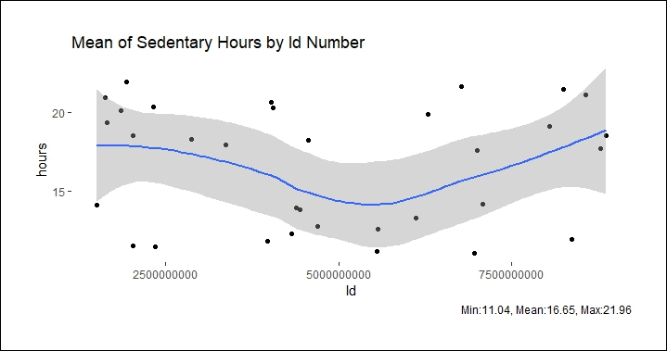
This is the mean number of sedentary hours by id number. It is apparent that sedentary hours, minus sleep, still leaves a lot of time available for some form of exercise.

Slide 8
Conclusions
The imaginary analyst was asked to analyze smart device usage data in order to gain insight into how consumers use non-Bellabeat smart devices. She then wants you to select one Bellabeat product to apply these insights to in your presentation. These questions will guide your analysis: 1. What are some trends in smart device usage? 2. How could these trends apply to Bellabeat customers? 3. How could these trends help influence Bellabeat's marketing strategy?
1. What are some trends in smart device usage?
2. How could these trends apply to Bellabeat customers?
3. How could these trends help influence Bellabeat's marketing strategy?
The trend for smart device usage is to integrate them into people's lives. We now have smart houses, locks, mechanical systems, security systems, and all manner of devices connected to apps on our cell phones. AI is now in the spotlight. Having an AI on our phones that can collect, analyze, and then make recommendations based on the data from all the other devices would be a benefit. For example, there is a lot of sedentary time each day, and the graphs show that people are not at an ideal number of steps or moderate to intense activity for maintaining optimal health. Having an AI explain why daily in a conversational mode might get people to be more active.
Another activity that seems to be lacking is sleep. The mean is 6.2 hours of sleep per night. That isn’t close to what is required. Having a GPS that knows when a user goes to Starbucks or another coffee shop near the end of the day might pop up a warning message from an AI. Too much caffeine at the end of the day isn’t a good thing for sleep. Having smart window blinds that close at a decent bedtime might be a good thing. The AI in an app can do this for the user. Avoiding e-mails, calls, or texts after hours could lower stress levels near bedtime, making sleep easier and getting more sleep per day.
While the number of steps is okay, it can be improved. If a watch has GPS on it, perhaps an AI can suggest a different place to go walking, running, or jogging. Using the same path day in and day out can make walking boring. Having new places to go can make users more likely to exercise. A set schedule and perhaps people to go with who are friends who live nearby would help. A friends list for exercising.
The marketing should include some of the conclusions that users would like to draw, with more sleep being the best. Tailor the app to help users get more sleep and do that with scheduling communications, blinds closing in the evening, and keeping people away from caffeine in the evenings. Reminders and scheduling instead of an AI should be doable with current hardware limitations.

